Slide 1
User guide Talent Onboarding Version 2

Slide 2
OVERVIEW
Internal information
What is Talent Onboarding?
Talent Onboarding Version 1 → Version 2
Set up Onboarding
Roles
Administration
Languages
Process templates
Employee portal
Start an onboarding process
Integrated solution
Stand alone solution
Processes overview & details
Invite employee to the employee portal
Emails & reminders

Slide 3
INTERNAL INFORMATION Configuration
Activation of Talent Onboarding solutions must be ordered by filling in this form:
https://tinyurl.com/vdn75pe
Note! "Personal info" is info about you.

Slide 4
INTERNAL INFORMATION Configuration (2)
When onboarding starts from Talent Recruiter these settings must be activated:
To be able to transfer candidates from candidate list to onboarding:
Onboarding Enabled
Two user roles has to be activated in order to access version 1 processes:
Access to onboarding
Administration – onboarding

Slide 5
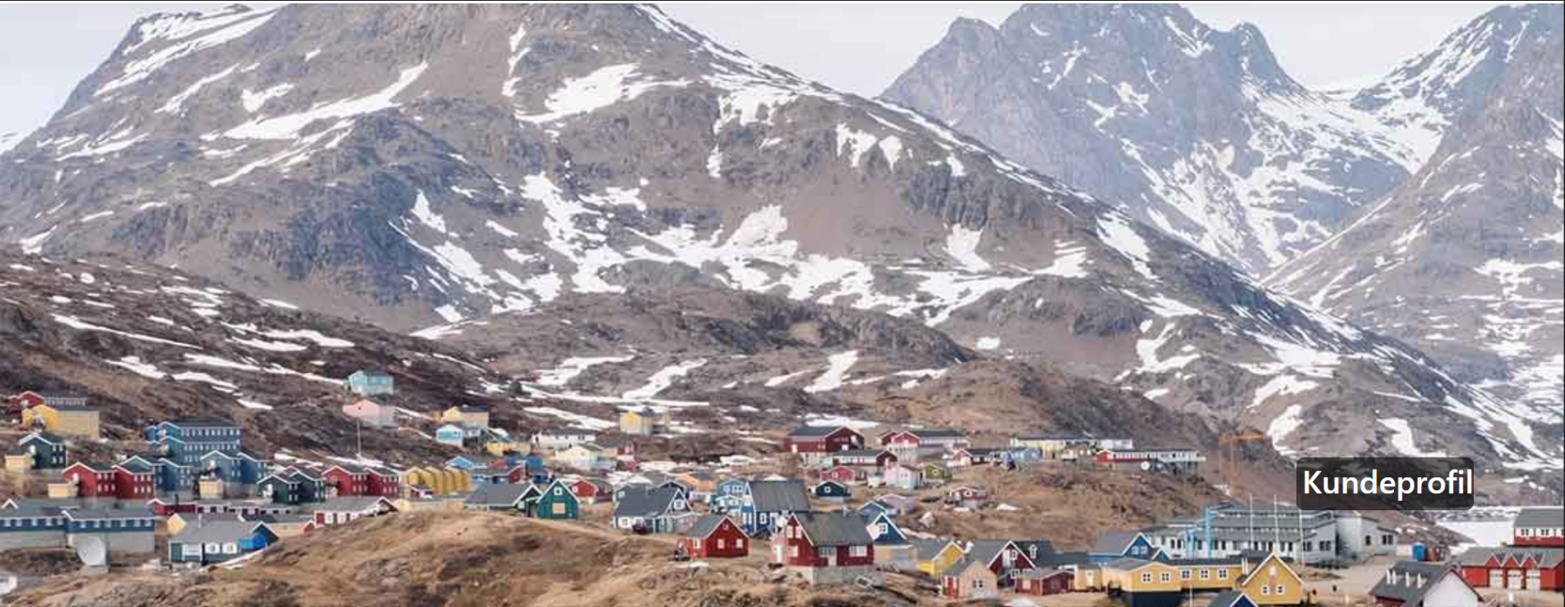
INTERNAL INFORMATION Configuration (3)
In Employee portal background picture and logo can be uploaded.
Background picture resolution (pixels):
W 2560 x H 640
Logo resolution (pixels):
W: 470 x H 150
Standard background if nothing is uploaded:
PLEASE NOTE: Logo and background can not be deleted
once uploaded.
But you can replace it with another logo and background.
Only developers are able to revert to the original background if needed.

Slide 6
INTERNAL INFORMATION
Ui culture=xx doesn't work. Change you language in My profil which is reacheable in the top right corner.
Processes can't be deleted at the moment, it's in development que. For now, they will remain in the system indefinitely.
Candidates have access to the employee portal until user removes the access. Even if the process is cancelled or is completed.
There are no hierachies or way to differentiate departments in onboarding. (slettet noe her)
Max size for attachments in a card in the employee portal is 20 MB.
Only users can cancel tasks.
Task assignees can start and complete tasks. (slettet noe her)
User won’t get notification if the candidate has answered questions, confirmed actions or read documents in Employee portal. But candidate can inform user about this via message in the chat card.
Only users can upload documents in portal, not candidates.
In some weeks it will be possible to brand each portal template.
Employee start date can’t be changed after starting a process. The possibility to do that is in development.

Slide 7
What is Talent Onboarding?
Talent Onboarding helps companies make professional, effective and time saving onboarding processes. It is one product, containing two modules: Process module and Employee portal.
Process module:
Create processes with tasks to be executed for new employees.
Reminders is automatically sent to task assignees and process owners.
Task assignee can be anyone with a mailadress. (Don’t need user access in the system).
Employee portal
Communicate and inform the new employees through documents, links, and video’s.
Fetch information.
Send instant messages.
Get verifications.

Slide 8
TALENT ONBOARDING VERSION 1 → VERSION 2
Customers that previously used TO version 1 can still handle their old processes via a link from TO version 2.
What to keep in mind if you have used version 1 before:
Your employee portal and branding will be kept in Onboarding version 2.
You need to create new process templates, including new tasks.
PLEASE NOTE: There is no task archive in version 2. If you want to reuse tasks for several templates, it’s best to copy a template and edit the tasks in the copy.

Slide 9
SET UP ONBOARDING
Before starting the onboarding process you need to:
Create an onboarding process template with tasks.
Create an employee portal, that the new employee can be invited to.

Slide 10
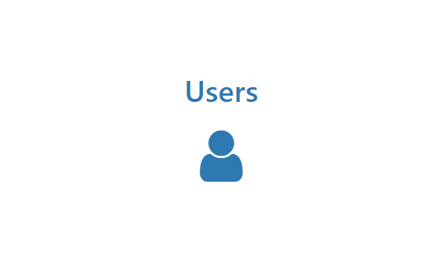
ROLES

Slide 11
ROLES
There are two user roles in Talent Onboarding:
User: Have access to all functions but Administration menu.
Users can select between all process templates when starting a process.
Users can only see their own processes.
Users can only see portals for their own processes.
Administrator: Have access to all functions including Administration menu.
Administrators can select between all process templates when starting a process.
Administrators can see all processes.
Administrators can see all process- and portal templates.
PLEASE NOTE: Task assignee does not need user access to Talent Onboarding. Task assignee can be anyone with an email address.

Slide 12
ADMINISTRATION
As an administrator, you can:
Create processes with unlimited number of tasks in Process templates.
Register users and roles in Users.
Set system e-mail language in Settings.
Create portals in Employee portal.
If you also are using Talent Recruiter, there is a shortcut to go back to Talent Recruiter.

Slide 13
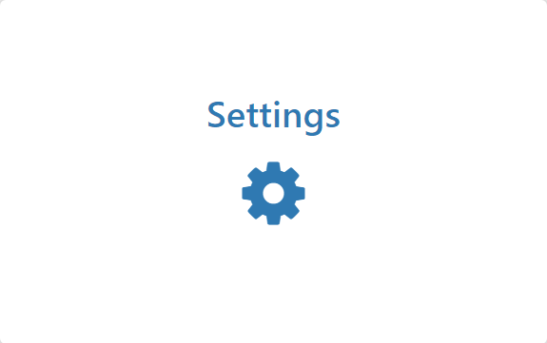
LANGUAGES

Slide 14
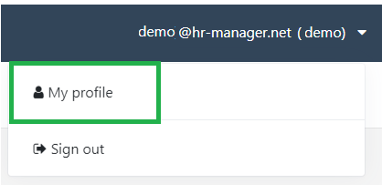
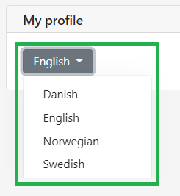
LANGUAGES
Languages available: Danish, English, Norwegian, Swedish.
One common system language for text in e-mails can be selected per solution. Multi language customers must agree on which system language to use.
Processes can be created in any language.
Users & Task assignees can individually select their own user system languages in My profile. If nothing is selected, the user language will be the same as the system language.

Slide 15
PROCESS TEMPLATES

Slide 16
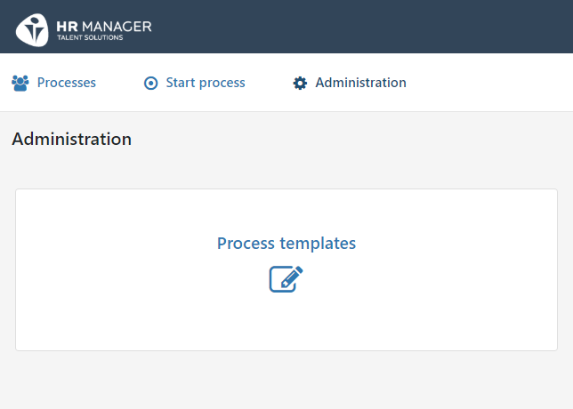
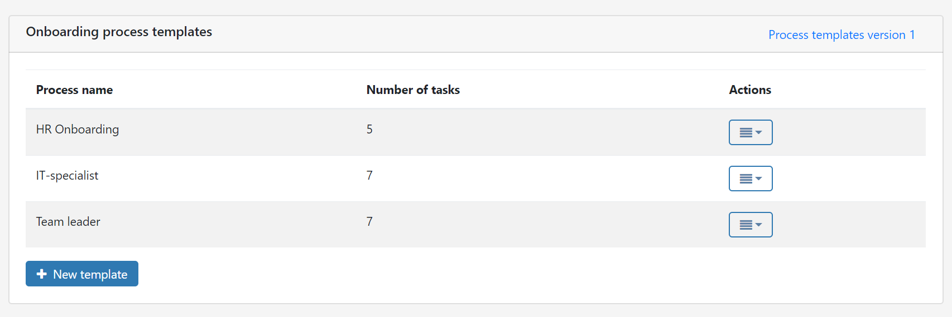
CREATE NEW PROCESS TEMPLATE
A new process template is created via: Administration → Process templates

Slide 17
CREATE NEW PROCESS TEMPLATE
PROCESS TEMPLATE
Give the process a name that makes it easy for user to pick the right one.
Press «New task» to add tasks to the process.
TASKS
Add a task to the process, including a task description, task deadline and task assignee.
Task description: In this field you may add details about the task.
Task deadline: Select a deadline for the task by entering amount of calendar days before or after the employee start date. Please note that weekends and holidays are included. When you start the onboarding process for an employee, the task due date will automatically be calculated by the system, based on employee start date.
Task assignee: Add task assignee to each task, if applicable, it’s not mandatory. If you don’t write anything in this field, you will type it in when starting the process instead.
2. Save the task and press «New task» if you want to add more tasks.
When all tasks have been created, finish by saving the process template. All changes are also auto saved.

Slide 18
PROCESS TEMPLATES
After saving the process template, you will see it in the overview of process templates.
If you want to make a similar process later and reuse tasks, you can copy the process template. You can easily edit the tasks in the copy, which will help you get a new process template, without having to rewrite all the tasks.
If you want to copy data from your processes in version 1, you can access version 1 by clicking here.
PLEASE NOTE: A process template that is deleted or changed will only affect future processes.

Slide 19
EMPLOYEE PORTAL

Slide 20
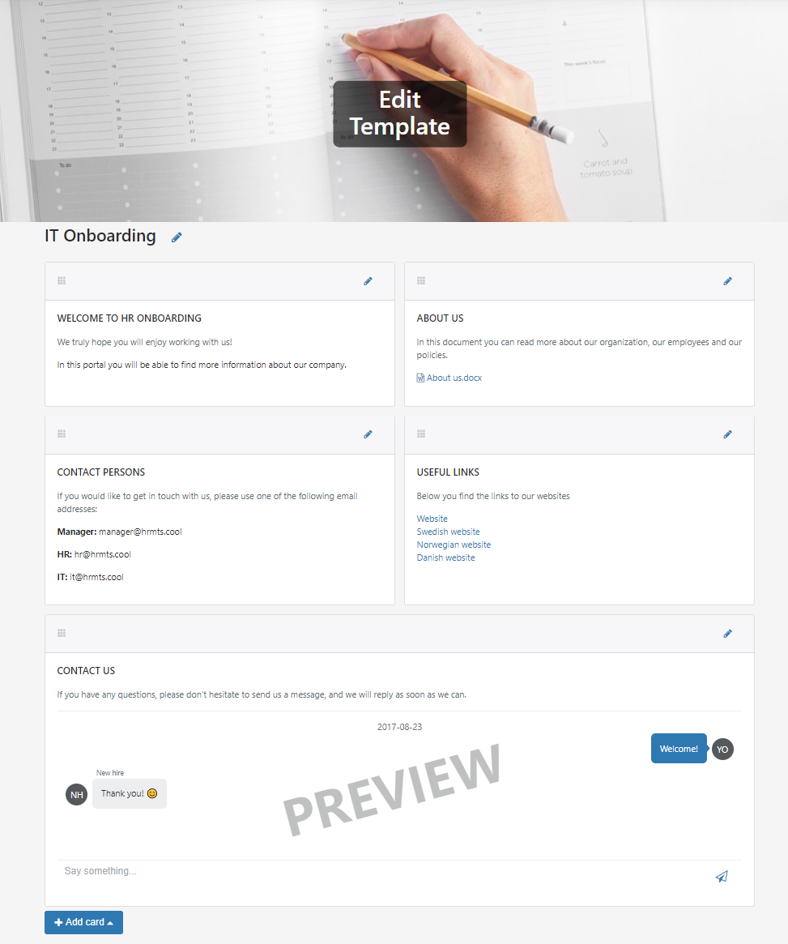
CREATE EMPLOYEE PORTAL
Make sure you have all information needed to create the portal.
Give the portal a name that makes it easy for user to pick the right one.
Build the portal using the available cards. The number of portals and cards are unlimited. Except for the Chat card.
PLEASE NOTE: All portal templates are available for the administrator role. Including templates made by other administrators.

Slide 21
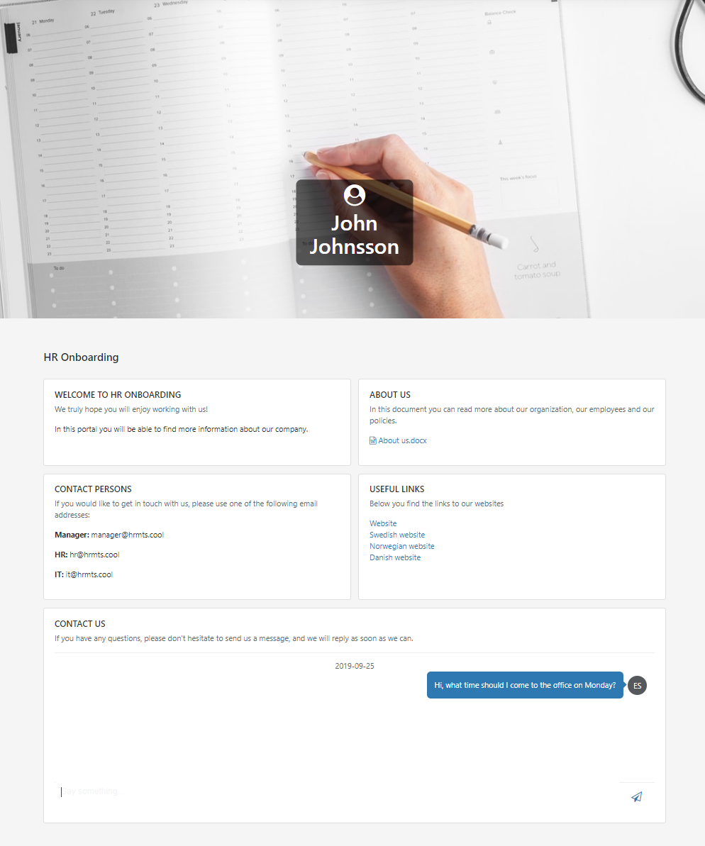
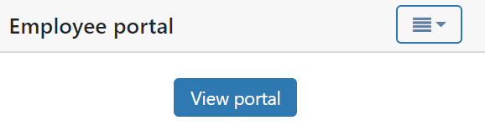
VIEW AN EMPLOYEE’S PORTAL
Via Processes → Edit process, you can view the employee’s portal.
Check if employee has responded to questions.
Check if employee has left a message.
This allows you to:
PLEASE NOTE: The process owner, that started the onboarding process, will get an email if the employee has replied to a chat and vice versa.

Slide 22
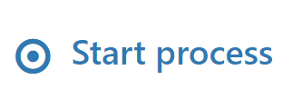
START AN ONBOARDING PROCESS

Slide 23
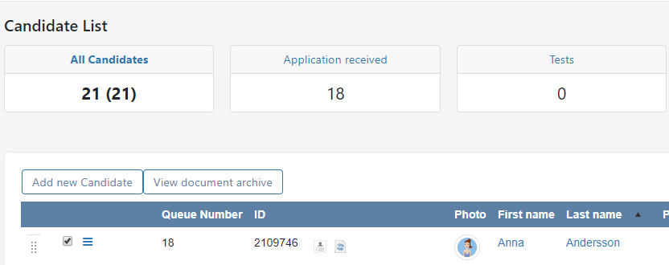
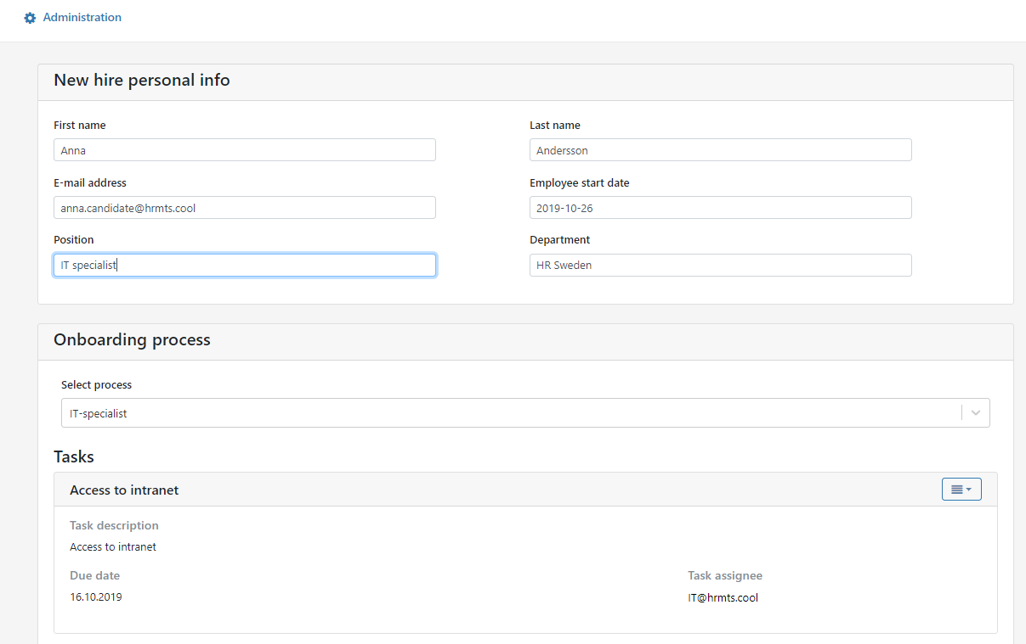
START PROCESS: Integrated solution
Select the candidate from the candidate list in the recruitment system.
The user that transfers the candidate is regarded as the process owner.
Information will be prefilled in the Start process screen. Select Employee start date and Onboarding process.
Recruitment system:

Slide 24
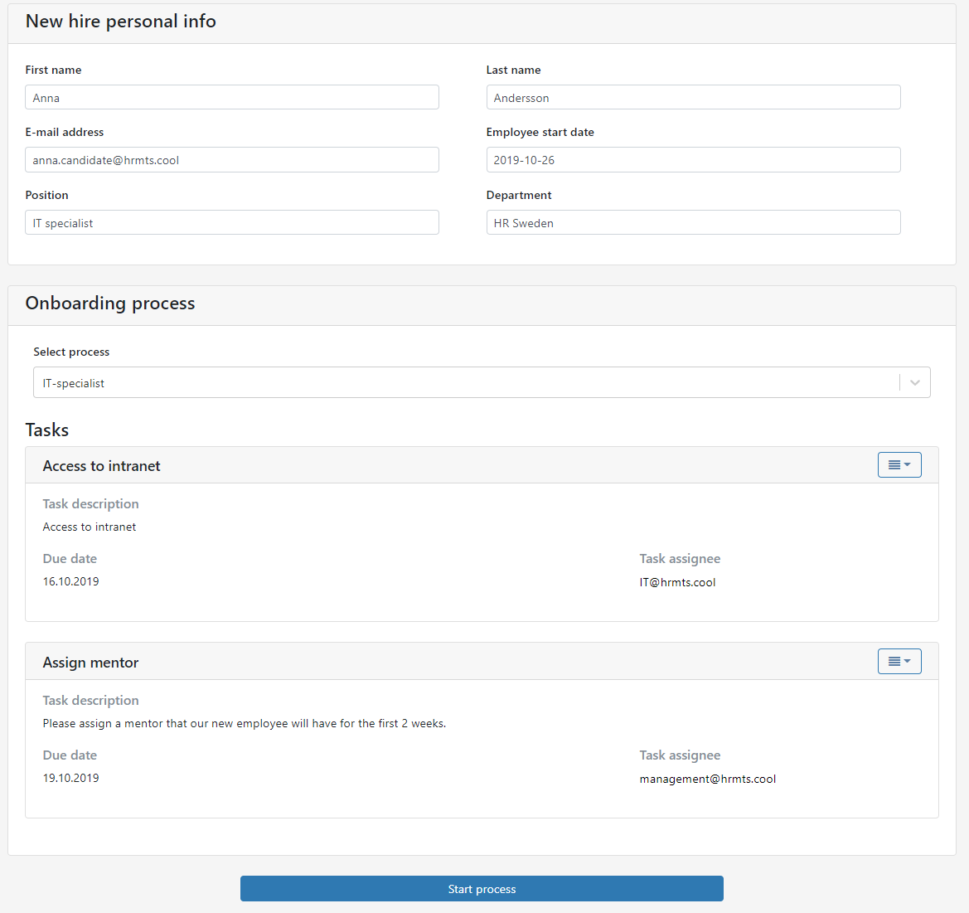
START PROCESS: Stand alone solution
Log into Talent Onboarding via: https://onboarding.hrmts.net/
Fill in employee information
Fill in employee start date.
Position and department is not mandatory.
Select and start process. The person who starts the process is regarded as the process owner.

Slide 25
PROCESS OVERVIEW & DETAILS

Slide 26
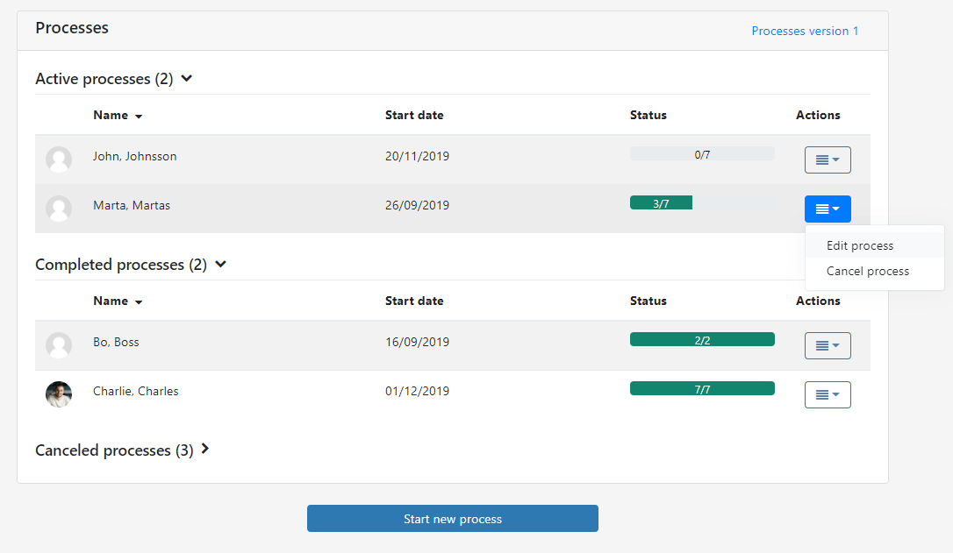
PROCESSES OVERVIEW
In the processes overview you will see all your active, completed and canceled processes.
Via edit process, you will get to the process details screen. There you will be able to view the details in your process and invite the employee to the portal.
Once all tasks in the process are completed, the process will automatically be moved from «active processes» to «completed processes».
Once all tasks in the process have been cancelled, the process will automatically be moved from «Active processes» to «Cancelled processes».

Slide 27
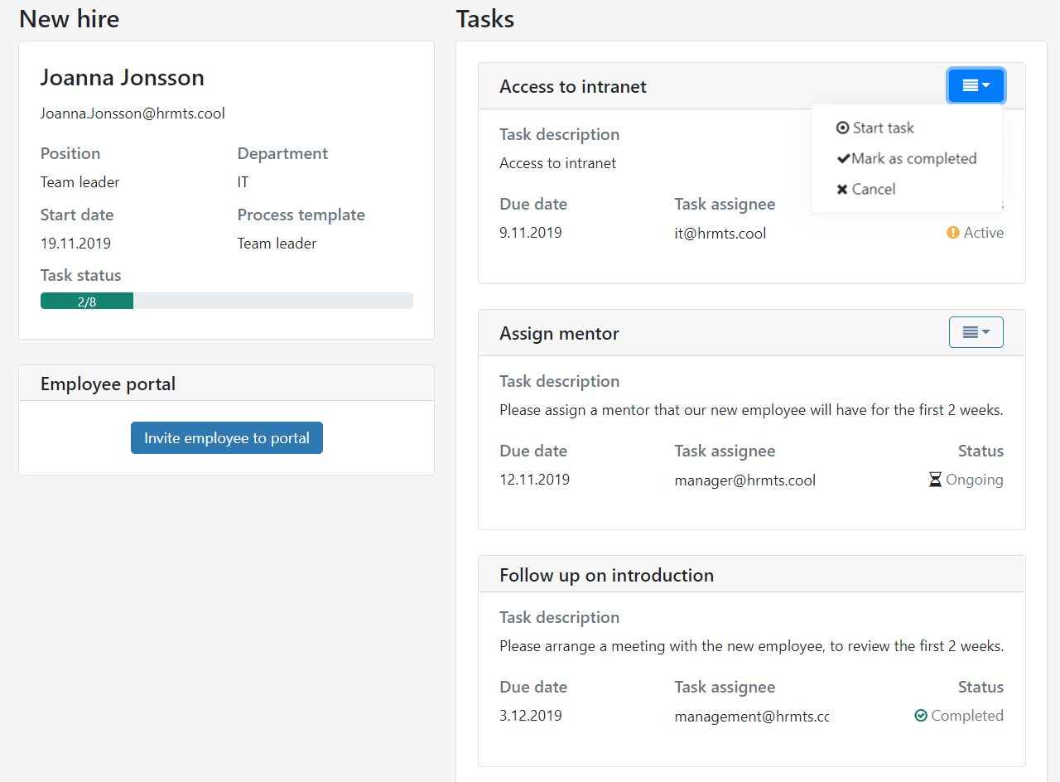
PROCESS DETAILS
On this page you can:
Start tasks for yourself or on behalf of task assignee.
Mark tasks as completed, for example if task assignee forgot to.
Cancel tasks that are no longer valid.
Invite employee to the employee portal, or view their portal.
See the status of tasks; active, ongoing, completed and cancelled.

Slide 28
INVITE EMPLOYEE TO THE EMPLOYEE PORTAL

Slide 29
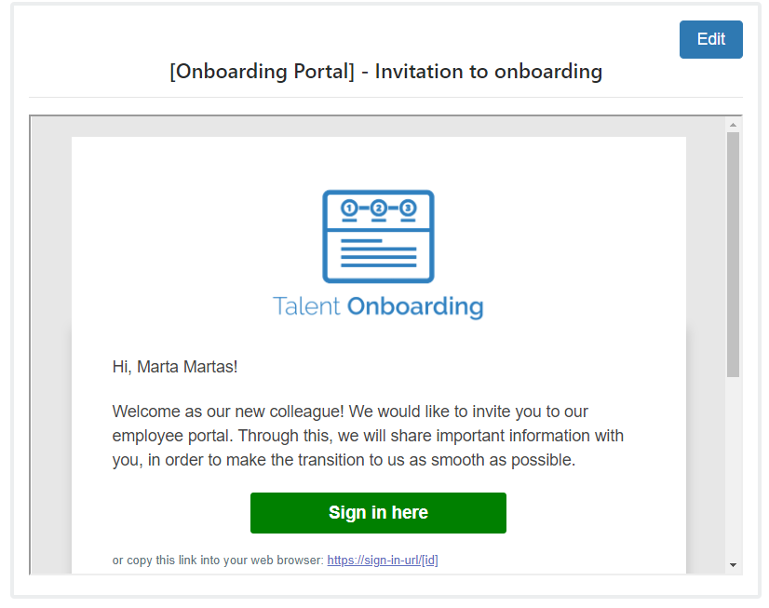
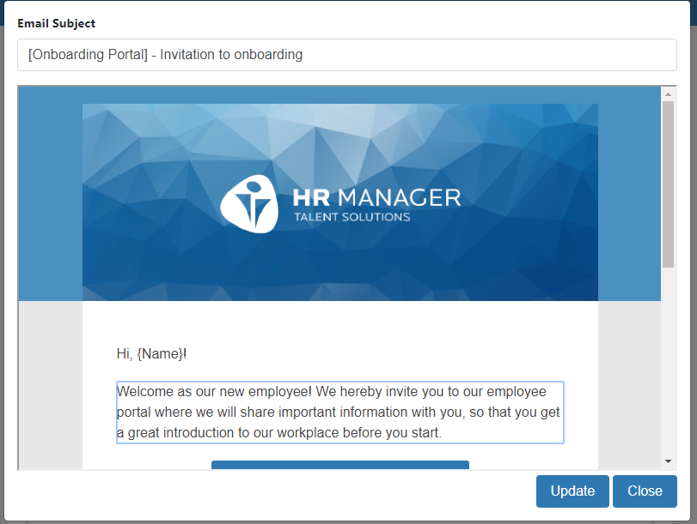
PORTAL INVITATION TO NEW EMPLOYEES
When you invite employees to the portal, you can edit the e-mail text prior to sending:
Press edit to adjust the text.
Click on the text you wish to edit.

Slide 30
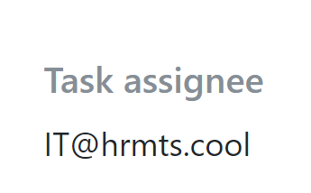
EMAILS & REMINDERS

Slide 31
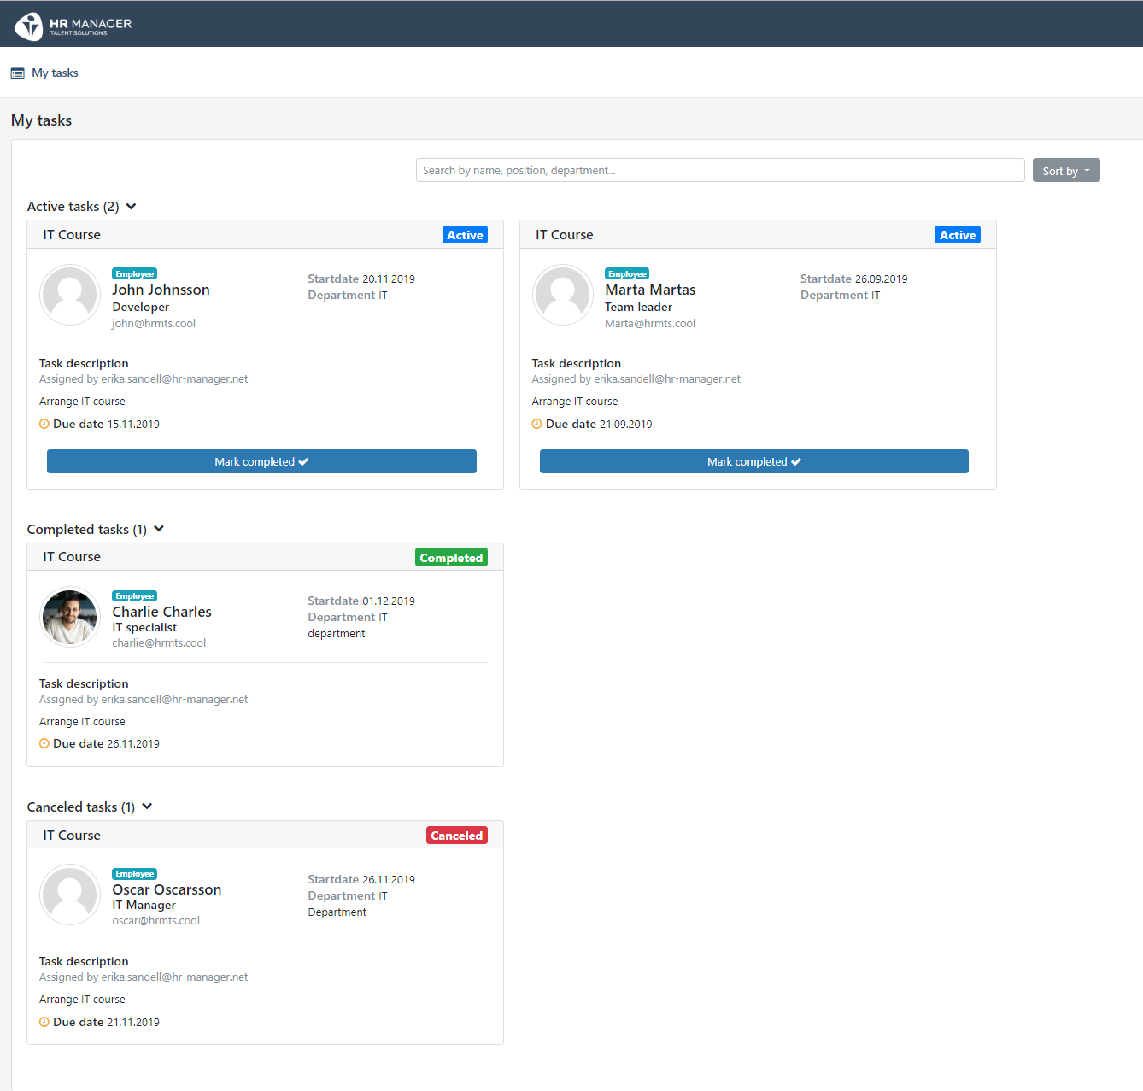
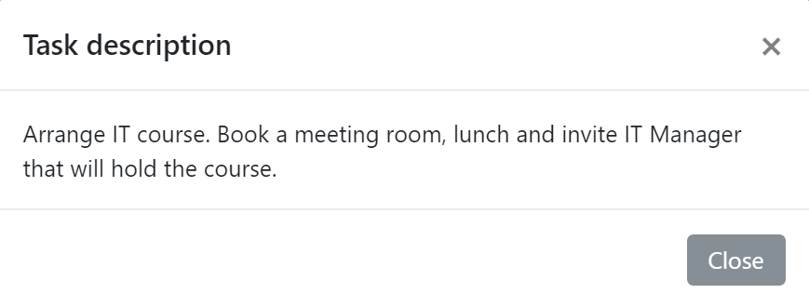
EMAIL ABOUT NEW TASKS
When a process starts, the task assignees will receive an e-mail immediately. There are no task details in the e-mails, the link will take the assignee to ”my tasks” in the system.
Click on the description for more details.

Slide 32
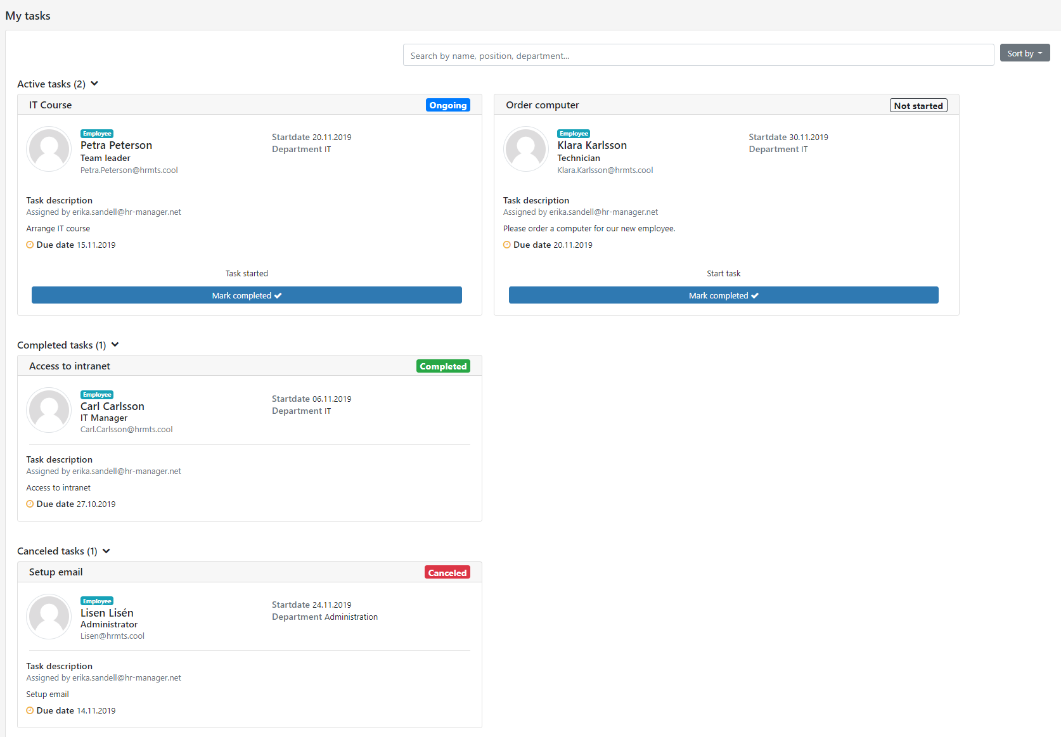
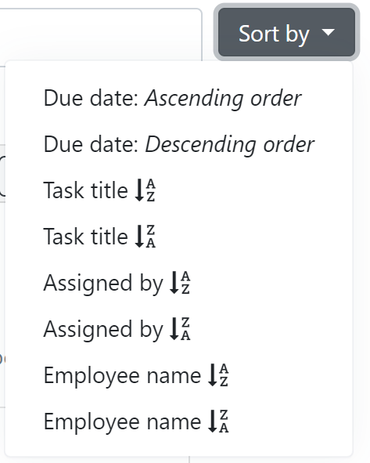
MY TASKS
In ”my tasks” the assignee can see all own tasks.
The tasks are grouped by status: active, completed and canceled.
The tasks can be sorted by:
The task assignee can start tasks or mark them as completed.
Each task is marked with current status: Ongoing, not started, completed, canceled.

Slide 33
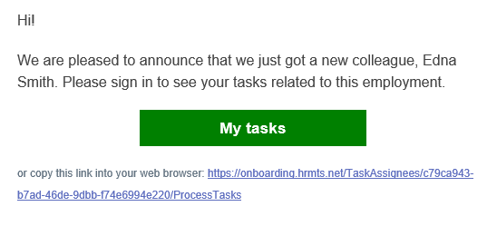
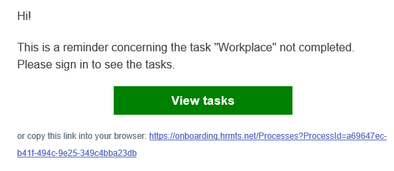
REMINDERS
Both task assignee and process owner will receive
two reminders for the tasks:
Seven days before due date
In the morning on due date
For task assignee:
For process owner:

Slide 34
CUSTOMIZATION
In Employee portal background picture and logo can be uploaded.
Recommended background picture resolution (pixels):
W 2560 x H 640
Recommended logo resolution (pixels):
W: 470 x H 150
Standard background if nothing is uploaded:
PLEASE NOTE: Logo and background can not be deleted
once uploaded.
But you can replace it with another logo and background.
Customer support can delete logo and reset background for you.

Slide 35
ADDITIONAL INFORMATION
Max size for attachments in a card in the employee portal is 20 MB.
Only users can cancel tasks.
User won’t get notification if the candidate has answered questions, confirmed actions or read documents in Employee portal. But candidate can inform user about this via message in the chat card.
Only users can upload documents in portal, not candidates.

