Slide 1
Quick Guide Webhooks

Slide 2
What’s a webhook
A webhook is an API concept that’s growing in poularity. As more and more of what we can do on the web can be described as events, webhooks are becoming even more applicable, they are incredible useful and a recource-ligth way to implement event reactions.
So, what exactly is a webhook?
A webhook(also called a web callback or http push api) is a way for an app to provide other applications with real-time information. A webhook delivers data to other applications as it happens, meaning you get data immediately. Unlike typical apis where you would need to poll for data every requently in order to get it real-time. This makes webhooks much more efficient for both provider and consumer.
Webhooks are sometimes reffered to as ”reverse apis” as they give yoyuo what amounts to an api spec, and you must design an api for the webhook to use. The webhook will make http request to your app ( typically a POST) and you will then be charged with interpreting it.

Slide 3
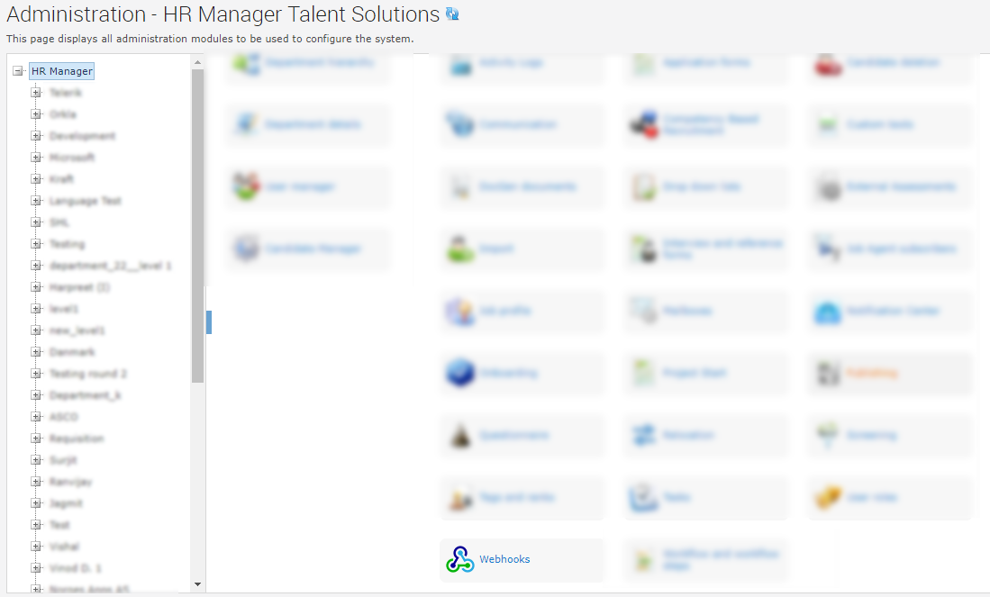
Setup in recruiter
In admin it’s a module called Webhooks where you can configure what urls we are going to post to on the different hooks that we support.

Slide 4
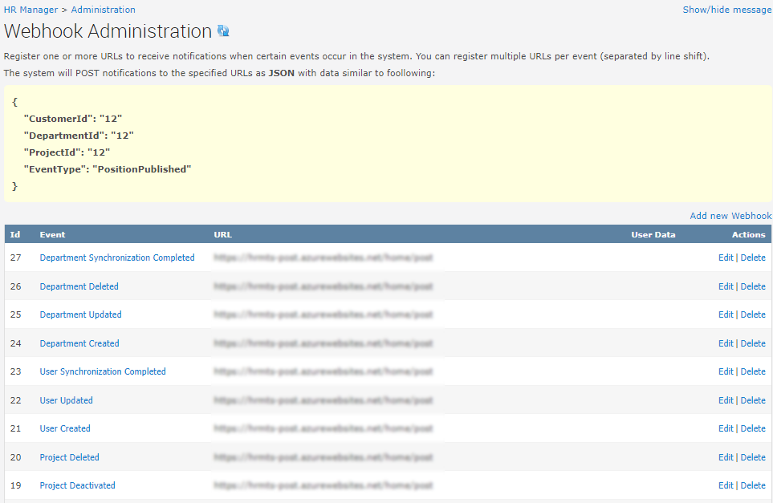
Setup in recruiter 1
This is the administration for webhooks, and where you define the the post url.

Slide 5
Setup in recruiter 2
Adding a new hook, by selecting the eventtype, the url where to post. And also you can include som static values that you want to be sent with the message.

Slide 6
Supported hooks
Position:
PositionPublished
PositionUnpublished
Project:
ProjectCreated
ProjectUpdated
ProjectDeleted
ProjectDeactivated
Mail:
SendCalendarInvite
Candidate:
CandidateRegistered
CandidateDeleted
CandidateUpdated
CandidateDeletedByUser
CandidateDeletedOwn
CandidateHired
Advertisement:
AdvertisementUpdated
AdvertisementPublished
AdvertisementUnPublished
LayoutTemplate:
LayoutTemplatePublished
LayoutTemplateUnpublished
Questionnaire:
QuestionnaireUpdated

Slide 7
Example client
To test if the webhooks works, you can use our example client we made.
You find it in our github repository:
https://github.com/hrmts/WebhookPostClient

Slide 8
You are now ready with webhooks please contact support if you have any questions
Telefon: +45 72 44 06 44
E-mail: support@hr-manager.dk
Chat med os

